Slide 1
The Purple Blossom
By: Ian Yarwood, Logan Stanley, Christian Schulitz, and Austin Amash

Slide 2
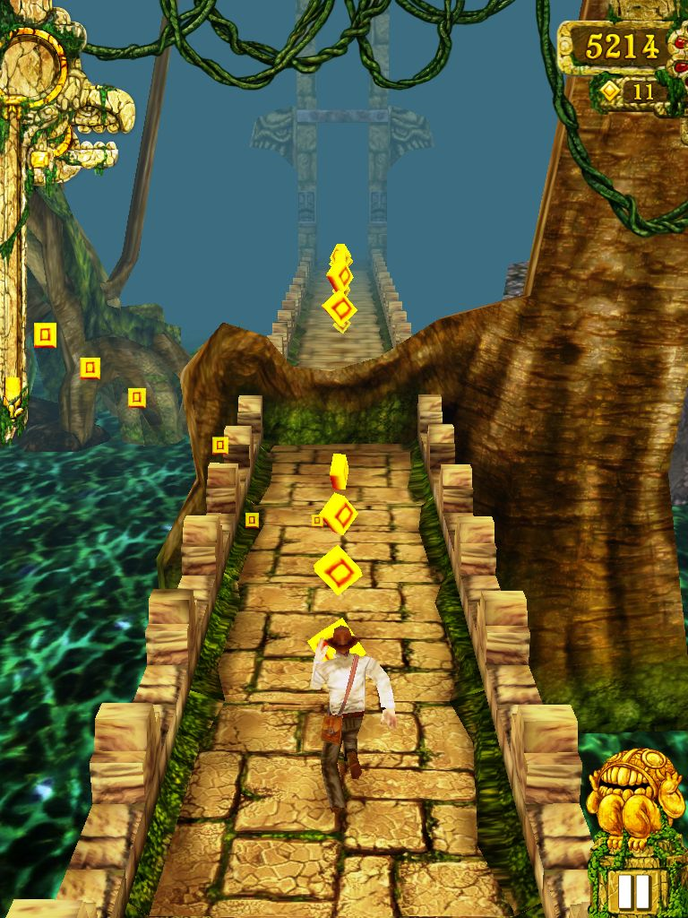
Genre
Runner/Platformer
Similar to games like Temple Run
https://thebinarymessiah.com/2012/04/04/temple-run-810/

Slide 3
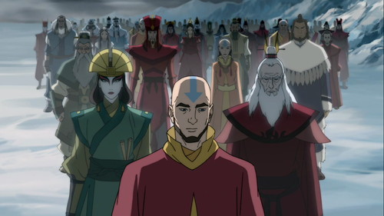
Story
Threat
The Green Lotus Brotherhood
Crimes against humanity
Stole the previous Purple Blossoms equipment
Main Character
The Purple Blossom
Inspiration drawn from Avatar
Goal
The Purple Blossom aims to free his country from the clutches of the Green Lotus
Retrieve his gear
Reason
The Green Lotus Brotherhood have taken over and thrown the once peaceful region into chaos
The Purple Blossom gets more powerful with each piece of gear he obtains
https://avatarfacts.tumblr.com/post/28691859251

Slide 4
Challenges
Enemies
The goal of each level will be to defeat an increasing in rank Green Lotus Member
I.e.. Level 1: Grunt -> Final Level: Lotus Boss
Obstacles
Laser Trap
Deadly Spikes
Poisonous Liquid

Slide 5
Features
Abilities
Each ability is gained through obtaining a piece of the Blossoms gear
Hype
The Purple Blossoms takes a unique spin on a Temple Run like game mixed with the ideas of our group

Slide 6
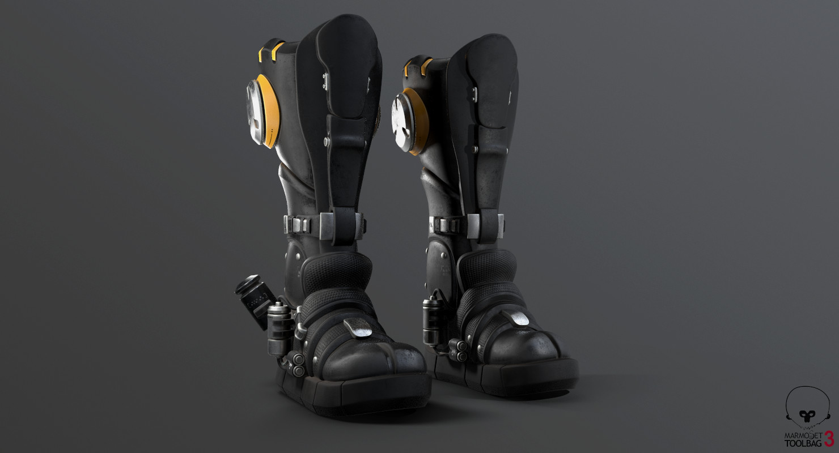
Abilities
Jumping
Due to the gravity on this planet, the average person can not even go up a flight of stairs
Even The Purple Blossom needs his leapers in order to be able to fight off the gravity
https://romale.artstation.com/projects/Lb9Bk

Slide 7
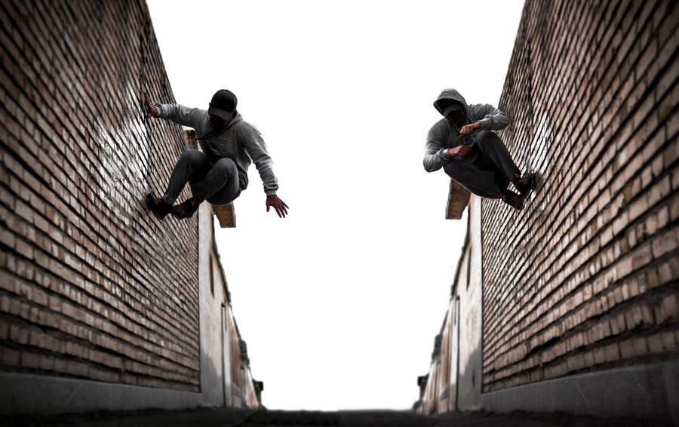
Abilities
Wall Running
The Purple Blossom can obtain an ancient scroll left behind by past Blossoms that will teach him how to focus his energy to run on walls
https://wallpapers.com/parkour

Slide 8

Abilities
Velocity Vortex
This cloak allows The Purple Blossom to cloak himself in a Vortex making him invisible and can phase through obstacles
Photo by mohammed idris djoudi on Unsplash

Slide 9
Levels
Each level will have the same basic format
These levels will increase in difficulty through speed as well as obstacle frequency
Each of these levels will have a Green Lotus Member at the end of the level that will be adding difficulty

Slide 10
Screen Shots

Slide 11
Status
Early Development
Idea is complete and we have a plan of action
Still working some kinks out to get the game to the idea in our heads

